Slide 1
Software Construction and Development
Week 12
Instructor :M Khizar Hayat
Unit Testing and Software Quality Assurance
Chapter 22, Code Complete
Chapters 8,9,15 Clean Code

Slide 2
Importance of Testing in Software Development
Detects bugs early, reducing future costs
Supports safe refactoring and feature extension
Improves maintainability and readability
Ensures software reliability and correctness
“Code without tests is not clean. It’s not even code.”

Slide 3
Challenges Without Testing
High maintenance cost
Increased risk of software failure
Hard to scale or modify code safely
Reduced developer confidence

Slide 4
Principles of Good Testing
Tests should be readable, well-structured, and maintainable
Fast execution and independent tests
Predictable and automated tests
Descriptive test names for clarity
Provides fast feedback

Slide 5
What is Unit Testing?
Tests individual components (methods/classes)
Validates expected behavior
Catches errors in isolation
Example: BankAccount class testing deposits, withdrawals, and invalid operations

Slide 6
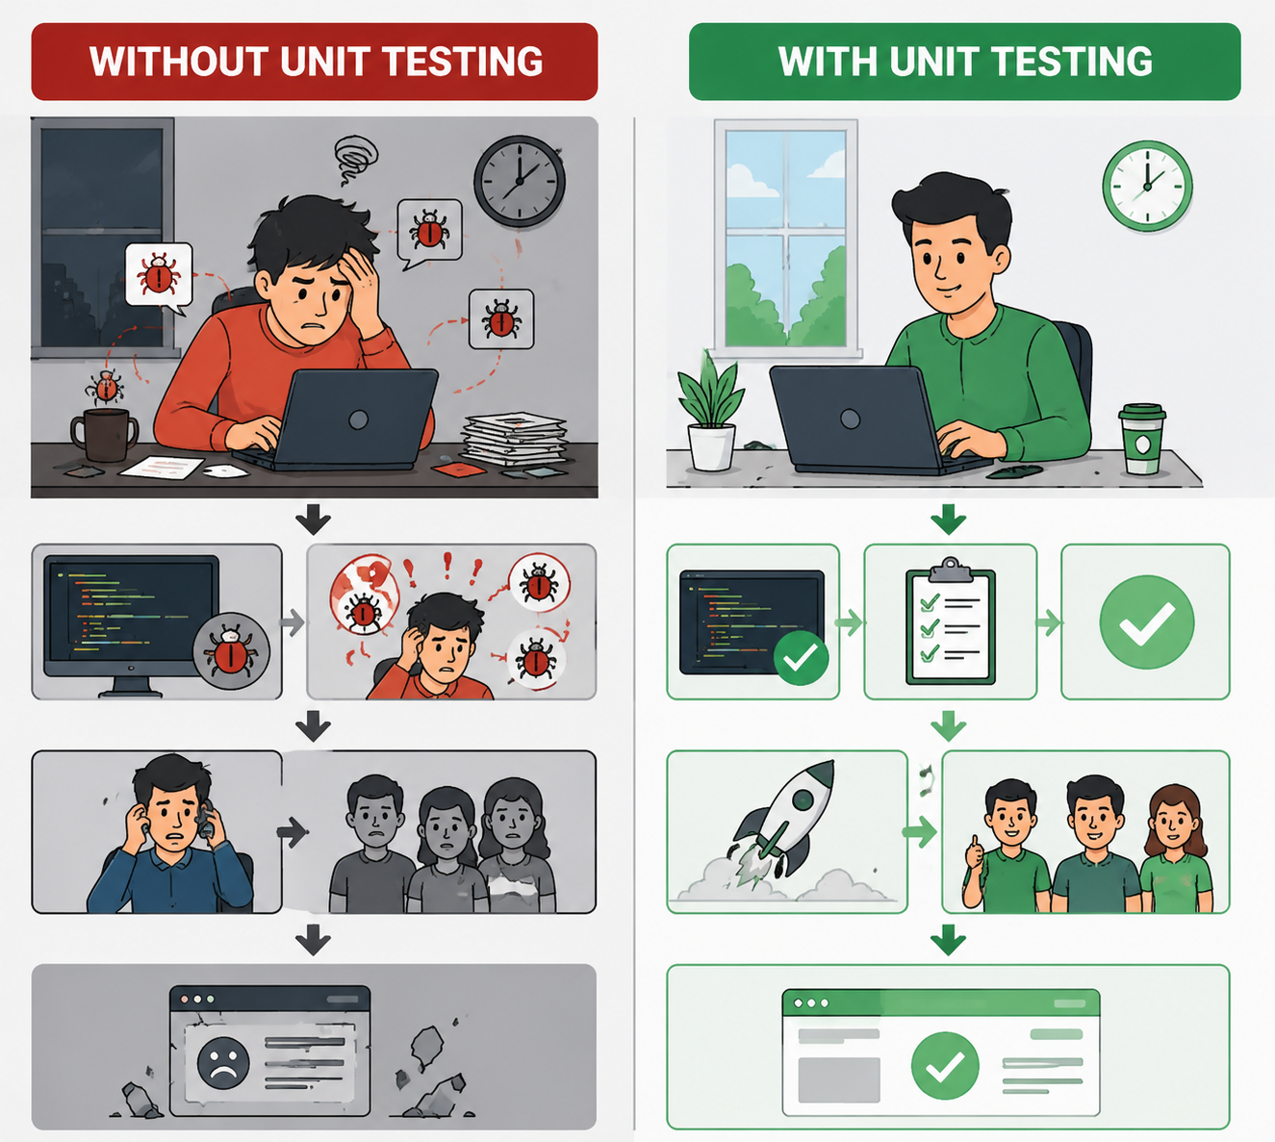

Slide 7
Benefits of Unit Testing
Early bug detection
Easier maintenance
Serves as documentation
Faster debugging
Encourages modular design

Slide 8
Test-Driven Development (TDD) Overview
Write tests before writing code
Laws of TDD:
    Don’t write production code without a failing test
    Don’t write more of a test than needed to fail
    Don’t write more production code than needed to pass
Encourages small, focused steps

Slide 9
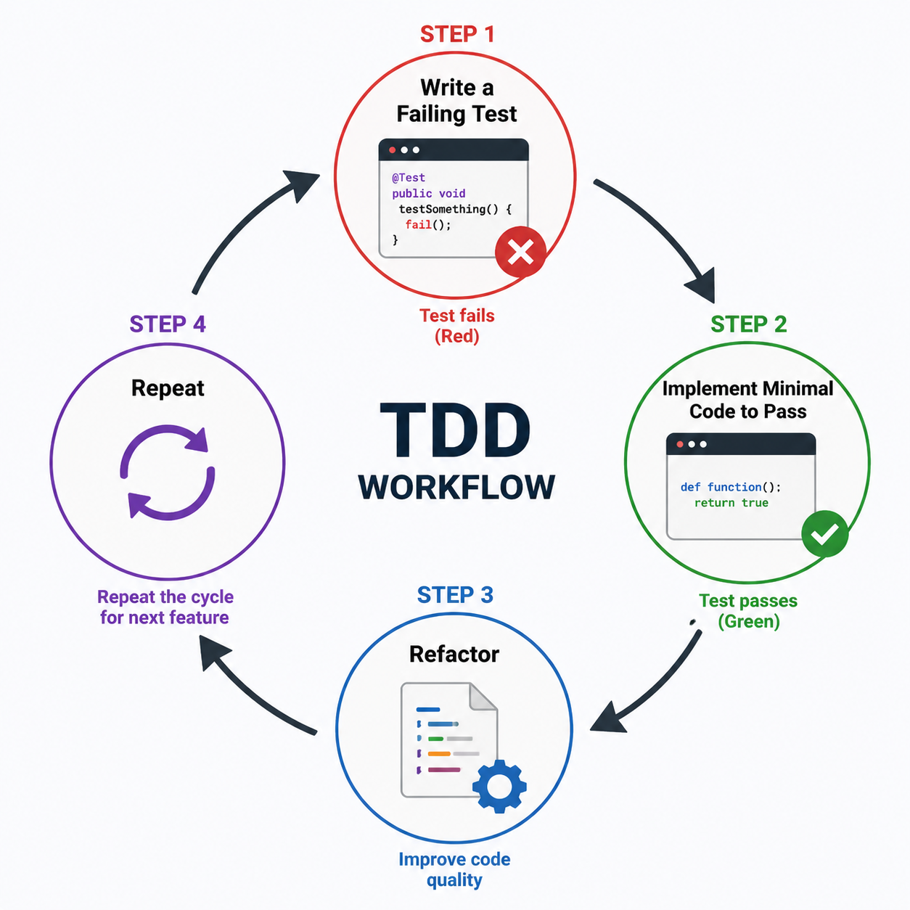
TDD Workflow

Slide 10
Red-Green-Refactor
RED: Write a test before writing the actual code.
The test should fail initially because the feature is not implemented yet.
This ensures the test is valid and meaningful.
Example:
@Test
public void testWithdrawMoreThanBalance() {
assertThrows(IllegalArgumentException.class, () -> account.withdraw(200));
}

Slide 11
Red-Green-Refactor (Cont....)
GREEN: Make the Test Pass
Write the minimum code required to pass the failing test
Focus only on functionality. Don’t worry about perfect design yet
The goal is to turn RED → GREEN.
Example:
public void withdraw(int amount) {
if (amount > balance) {
throw new IllegalArgumentException();
}
balance = balance - amount;
}

Slide 12
Red-Green-Refactor (Cont....)
REFACTOR: Improve the Code
Improve the code structure without changing its behavior
Remove duplication and improve readability
Ensure all tests still pass after changes
Example:
public void withdraw(int amount) {
validateWithdrawal(amount);
balance -= amount;
}
private void validateWithdrawal(int amount) {
if (amount > balance) {
throw new IllegalArgumentException();
} }

Slide 13
Practice Question: TDD Cycle
You are required to develop a Simple Calculator System using the Test-Driven Development (TDD) approach. The system must include a method called add() which:
Takes two integers as input
Returns their sum
Your task:
Using the Red-Green-Refactor cycle:
Write a failing test case (Red phase) for the add() method.
Write the minimum code (Green phase) to pass the test.
Improve the code using Refactor phase without changing its behavior.

Slide 14
Unit Testing Frameworks
JUnit (Java): Widely used for Java applications; supports both JUnit 4 & 5; allows annotations like @Test, @Before, @After; integrates easily with CI/CD pipelines.
PyTest (Python): Flexible Python testing framework; supports fixtures, parameterized testing, and plugins; easy syntax for writing simple to complex tests.
NUnit (.NET): Framework for .NET applications; similar to JUnit; provides test runners and rich assertions; integrates with Visual Studio and build pipelines.

Slide 15
Key Principles of Frameworks
Clean Tests: Easy to read, understand, and maintain
Fast Execution: Quick feedback for developers
Independent Tests: Each test should run in isolation without dependencies
Readable and Descriptive: Test names and assertions should document expected behavior
Automation-Friendly: Integrates with build systems and CI/CD for continuous testing

Slide 16
JUnit 4 Overview
Released in 2006, widely adopted
Uses @Test, @Before, @After annotations
Runs all tests in a single engine
Simple setup for unit tests

Slide 17
JUnit Testing – Example (JUnit 4)
import static org.junit.Assert.*;
import org.junit.Before;import org.junit.Test;
public class BankAccountTest {
private BankAccount account;
@Before
public void setUp()
{
account = new BankAccount(100.0);
}

Slide 18
@Test
public void depositShouldIncreaseBalance() {
account.deposit(50.0);
assertEquals(150.0, account.getBalance(), 0.001);
}
@Test(expected = IllegalArgumentException.class)
public void shouldNotDepositNegativeAmount() {
account.deposit(-10.0);
}
}
Focus: small, independent, clear tests

Slide 19
Practice Example – Student Grading System
Student Class:
public class Student {
private int marks;
// constructor to set marks
public Student(int marks) {
this.marks = marks;
}
// returns grade based on marks
public String getGrade() {
if (marks >= 80) {
return "A";
}

Slide 20
else if (marks >= 60) {
return "B";
} else if (marks >= 40) {
return "C";
} else {
return "F";
}
}
// checks if student is passed
public boolean isPassed() {
return marks >= 40;
}
}

Slide 21
Writing Unit Tests Using JUnit 4
import static org.junit.Assert.*;
import org.junit.Before;
import org.junit.Test;
public class StudentTest {
private Student student;
// used to create common test setup
@Before
public void setUp() {
student = new Student(75); // default marks for testing
}

Slide 22
// Test 1: grade for high marks
@Test
public void shouldReturnGradeAForHighMarks() {
student = new Student(85); // override default
assertEquals("A", student.getGrade());
}
// Test 2: grade for medium marks
@Test
public void shouldReturnGradeBForMediumMarks() {
student = new Student(70);
assertEquals("B", student.getGrade());
}

Slide 23
// Test 3: grade for low marks
@Test
public void shouldReturnGradeFForLowMarks() {
student = new Student(30);
assertEquals("F", student.getGrade());
}
// Test 4: student passes
@Test
public void shouldReturnTrueWhenStudentPasses() {
student = new Student(60);
assertTrue(student.isPassed());
}
// Test 5: student fails
@Test
public void shouldReturnFalseWhenStudentFails() {
student = new Student(20);
assertFalse(student.isPassed());
}
}

Slide 24
JUnit 5 Overview
Released in 2017, modern replacement of JUnit 4
Uses @Test, @BeforeEach, @AfterEach annotations
Supports modular testing architecture (JUnit Platform, Jupiter, Vintage)
Better extension model and improved flexibility
Works well with Maven, Gradle, and CI/CD tools

Slide 25
JUnit Testing – Example (JUnit 5)
Student Class (Already Defined)
The Student class is already implemented (see Slide 19-20)
It contains logic to calculate grade based on marks
It also checks whether a student has passed or failed
Now Test cases are written separately using JUnit 5

Slide 26
JUnit Testing – Example (JUnit 5)
import static org.junit.jupiter.api.Assertions.*;
import org.junit.jupiter.api.BeforeEach;
import org.junit.jupiter.api.Test;
public class StudentTest {
private Student student;
// runs before each test case
@BeforeEach
public void setUp() {
student = new Student(75);
}
}

Slide 27
// Test Case: Grade A
@Test
public void shouldReturnGradeAForHighMarks() {
student = new Student(90);
assertEquals("A", student.getGrade());
}
// Test Case: Grade B
@Test
public void shouldReturnGradeBForMediumMarks() {
student = new Student(70);
assertEquals("B", student.getGrade());
}
// Test Case: Fail Grade
@Test
public void shouldReturnGradeFForLowMarks() {
student = new Student(30);
assertEquals("F", student.getGrade());
}

Slide 28
// Test Case: Pass / Fail Check
@Test
public void shouldReturnTrueWhenStudentPasses() {
student = new Student(60);
assertTrue(student.isPassed());
}
@Test
public void shouldReturnFalseWhenStudentFails() {
student = new Student(20);
assertFalse(student.isPassed());
}

Slide 29
Best Practices for Unit Testing (JUnit)
Write small, single-purpose tests
Use clear and descriptive test names
Keep tests independent from each other
Use setup methods (@Before / @BeforeEach) to avoid repetition
Test normal, edge, and invalid cases
Keep tests simple and fast
Follow Arrange–Act–Assert (AAA) pattern
Use appropriate assertions (assertEquals, assertTrue, etc.)

Slide 30
Thank You!

